Slide 1
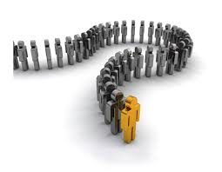
Sprint retrospective Office Queue Management
Barco Luca
Chen Jinzhuo
Farhadov Elchin
Finocchiaro Loredana
Laudani Daniele
Nicolò Antonino
SE2 - Team 8

Slide 2




Implementation choices
Web application + client-server model
Coding
Client: React.js
Server: Node.js
DBMS: Sqlite
Testing
Jest + Enzyme

Slide 3

Process
Macro and detailed statistics

Slide 4
Stories (included in the Sprint)
OQ-1 AS AN officer I WANT TO press a button SO THAT I can call and serve the next user
OQ-2 AS A customer I WANT TO know the average waiting time needed to process my request
OQ-3 AS A customer I WANT TO know the ticket number that is being served in a certain moment
OQ-4 AS A customer I WANT TO know the ticket number assigned by the counter
OQ-5 AS A customer I WANT TO see on the main display board the queue’s length
OQ-9 AS A customer I WANT TO pick a ticket for a specific service type SO THAT I can be inserted in the queue

Slide 5
Stories (not included)
OQ-6 AS A manager I WANT TO configure service time for each service type
OQ-7 AS A manager I WANT TO configure the request types that could be served for each counter SO THAT counters could be organized properly
OQ-8 AS A manager I WANT TO list the history of requests for each service type SO THAT I can compute statistics per day/week/month

Slide 6
Macro statistics
Number of stories committed vs done: 6/6
Total points committed vs done: 17/17
Team of 6 members → Planned hours: 6 * 8 ph = 48 ph
Number of hours planned vs spent (as a team): 48/50
For detailed timesheets, we used the Clockwork Free application.

Slide 7
Detailed statistics
Story ID | Number of tasks | Points | Total hours estimated | Total hours spent
OQ-1 | 3 | 5 | 9 ph | 13.5 ph
OQ-2 | 1 | 3 | 1 ph | 1.5 ph
OQ-3 | 1 | 2 | 1.5 ph | 3 ph
OQ-4 | 1 | 2 | 0.5 ph | 0.25 ph
OQ-5 | 2 | 2 | 0.5 ph | 0.5 ph
OQ-9 | 3 | 3 | 11 ph | 10.5 ph
Hours per task: 2.65 (avg), 4.27 (σ)
Total task estimation error ratio (hours estimated/tot): 23.5/29.25 = 0.8
(Missing hours regard more general tasks, which were not considered as subtasks of stories)

Slide 8
Statistics about horizontal tasks
Such as «Toolkit setup», «Discuss about architecture to be choosen for the system», «Implement communication with the db», «Study how to perform testing», …
Number of tasks | Total hours estimated | Total hours spent
9 | 16 | 20.75 ph
Hours per task: 2.3 (avg), 3.68 (σ)
Total task estimation error ratio (hours estimated/tot): 16/20.75 = 0.77

Slide 9

Quality
Testing and coding review

Slide 10
Unit Testing
Total hours estimated: 7 ph
Total hours spent: 9 ph
N° of automated unit tests: 11

Slide 11
Integration testing
Total hours estimated: 3 ph
Total hours spent: 5 ph
N° of automated unit tests: 3

Slide 12
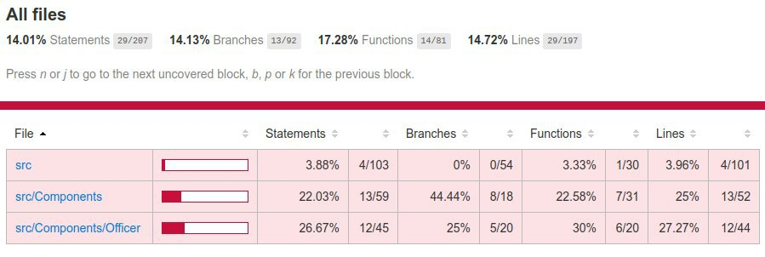
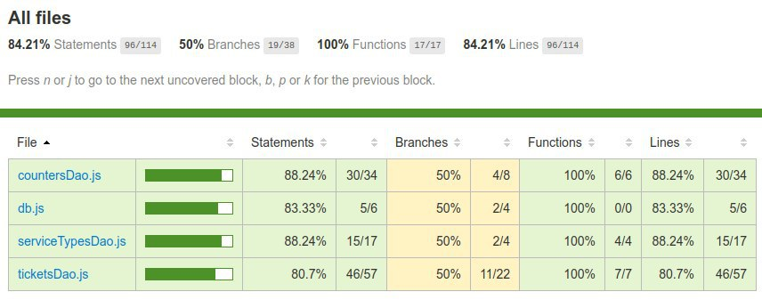
Coverage
CLIENT
SERVER

Slide 13
Code review
Total hours estimated: ?
Total hours spent: ?

Slide 14

Assessment
How did it go?

Slide 15
Did you complete all the planned stories? If no, why?
Yes, we were able to complete all the planned stories.
Although, we made an error: we considered as «Done» stories correctly implemented, but not yet tested.
Testing was considered among more general tasks, that were not completed entirely.

Slide 16
What caused your errors in estimation (if any)?
We spent, more or less, 6 ph more with respect to the estimation. Furthermore, we noticed that hours spent for each story are often not so coherent with the points assigned to that story.
The reason for underestimating is maybe due to not so great experience in managing the choosen implementation technology and in aligning own work with those of other members, that caused a bit of a waste of time.
We can conclude we surely need to learn still a lot about estimation.

Slide 17

What lessons did you learn (both positive and negative) in this Sprint?
Coordination between team members was quite good, but it’s always possible to do better for the future.
We reached our objective about completing all the committed stories.
We gained many positive feedbacks from the stakeholders.
We had many issues concerning testing, because of very little experience about that.
We should improve our capability of estimating.

Slide 18
Propose 1 or 2 improvement goals for the next sprint and specify how to achieve them (technical tasks, team coordination, etc.)
Each of us should learn how to do testing in the choosen framework (since this is new for all of us) and test all the functions as soon as these are completed (only at that point the task can be considered as «Done» officially). This can be reached by studying documentations online individually and then we can meet and discuss together, trying to find a common line.
Aligning skills as much as possible could be useful for learning more, better and reciprocally, considering that some of us don’t have so many skills about React.js. This can be easily obtained by permitting team members to assist other team members while they’re working.

Slide 19
One thing you are proud of as a team
We are 6 different people, with different timetables/interests/skills (and time zones, too), but this first Sprint demonstrated that working together with «love and agreement» is possible, thanks to the fact that all of us are willing to listening, dialogue and discuss peacefully.
We surely think there are many perspectives of improveness as a team and that there are all the conditions to do a good job together.

